Slide 1
Movie Recommendation System using Graphs
Design and Analysis of Algorithms Course Project

Slide 2
Group Details
Division : TY-C
Group Number : 4
Batch : 1
NAME | ROLL NO. | GR. NO
Balaji Padamwar | 30 | 11810391
Aditya Pangaonkar | 35 | 11810143
Shriram Pareek | 37 | 11810686
Kishan Partani | 39 | 11810403
Tejas Pradhan | 63 | 11810134

Slide 3
Introduction

Slide 4
Overview
Current movie recommendation systems have collaborative as well as content based filtering systems which are designed using specific machine learning algorithms.
We have developed a practical recommender system using Graph algorithms and Graph database.
We have also added additional features to give details about the dataset used such as number of connected components, min max connected components and cyclic check.
These features give the user better recommendations and more insights about the data

Slide 5
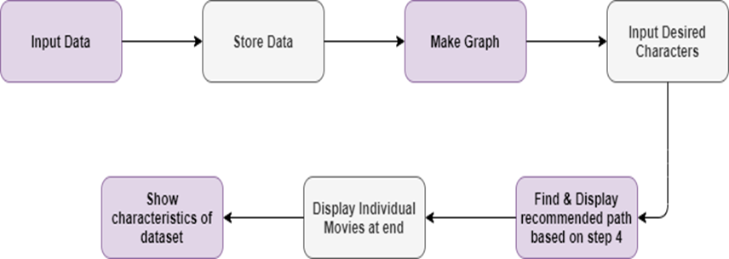
Block Diagram

Slide 6

Inputs and Pre-processing
Map is used to process the actors of dataset, their movies along with the entire cast as it does the required task in the fastest way possible.
The dataset consists of all the actors and movies. Individual films of each actor is also maintained along with the movies in common.
Actors and movies together form the vertices of the graph. These actors are mapped to their respective movies. All the connections among them are assigned with weight 1.
At the very end of input, two actors are provided for querying and recommendations.

Slide 7
Features of Our System

Slide 8
Identifying if movies can be recommended
Strategy: To find the number of connected components in the graph
Connected Components in an undirected graph
Case A: One Connected Component
Case B: More than One Connected Component
Application in Movie Recommendation ??
Connected Component sets are pairwise disjoint

Slide 9
Algorithm
Initialize all vertices as not visited
Do the following for every vertex v:
If ‘v’ is not visited before, call DFSUtil(v)
Count = Count + 1
3) Print Count
Function DFSUtil(v)
Mark ‘v’ as visited
Do the following for every adjacent ‘u’ of ‘v’
If ‘u’ is not visited, recursively call DFSUtil(u)

Slide 10
Time Complexity
If, Adjacency List is used -
DFS - Visits each vertex once & each edge twice
Checking of vertex status - O(1)
Total Time Complexity - O ( V + E )
If, Adjacency Matrix is used - O ( V^2)
DFS - O (V^2)
Checking of vertex status - O(1)
Total Time Complexity - O ( V^2 )

Slide 11
Finding Best Movie Recommendation
Strategy: Finding Shortest path from source to destination and recommending the movies in the path
The two given actors/actresses are stored as source and destination vertices.
Modified Dijkstra’s Algorithm is called with given input and Shortest path is calculated.
This path is then stored and movies as well as actors and actresses are extracted from the path and than stored separately.
These movies are than added with individual movies of the given actors/actresses.
Final Recommendation List is than given as output

Slide 12
Underlying Algorithm (Modified Dijkstra’s Algorithm)
1) Initialize distances of all vertices as infinite.
2) Create an empty priority_queue pq. Every item of pq is a pair (weight, vertex).
3) Insert source vertex into pq and make its distance as 0.
4) While either pq doesn't become empty
a) Extract minimum distance vertex from pq. Let the extracted vertex be u.
b) Loop through all adjacent of u and do following for every vertex v.
If dist[v] > dist[u] + weight(u, v)
(i) Update distance of v, i.e., do dist[v] = dist[u] + weight(u, v)
(ii) Insert v into the pq (Even if v is already there)
(iii) Modify the parent array
5) Print required path using parent array

Slide 13
Complexity Analysis
1) Adding all |V| vertices of the graph to a Priority Queue takes a total of O(|V|) time.
2) We can remove and read a vertex to a Priority Queue in O(log|V|) time
Since each priority value update takes O(log|V|) time, the total of all priority value updates takes O(|E|log|V|).
3) Dijkstra's algorithm only removes from the priority queue |V| times, and each removal takes O(log|V|) time for a total of O(|V|log|V|) time for all vertex removals.
4) Adding these running times together, we have O(|E|log|V|) for all priority value updates and O(|V|log|V|) for removing all vertices. This means the running time for Dijkstra's algorithm using a priority queue is O((|E|+|V|)log|V|).

Slide 14
To check if there are multiple links between actors/actress
Strategy :- Find all possible paths from the source vertex to the destination vertex where source and the destination vertex are the favourite actors/actresses entered by the user.
Method used here to find the cycle having 2 of the nodes as actors/actress entered by the user is DFS.
There is cycle in graph only if there is a back edge present in the graph.
IsCyclic and isCylicutil are the functions used to check if there is cycle present in the graph

Slide 15
Algorithm for cycle detection in the graph
Graph is created using given number of vertices and edges.
Recursive function is created having current index, visited and recursion stack.
Then current node is marked as visited and also the index in recursion stack is marked.
Then all the vertices that are not visited and are adjacent to the current node are found out and a recursive call is given for those vertices,
if recursive function return true then return true
else return false
If the adjacent vertices are already marked in the recursion stack then return true.
Then a wrapper class is created, that calls the recursive function for all the vertices and if any function returns true then return true.
Else if for all the vertices the function returns false return false.

Slide 16
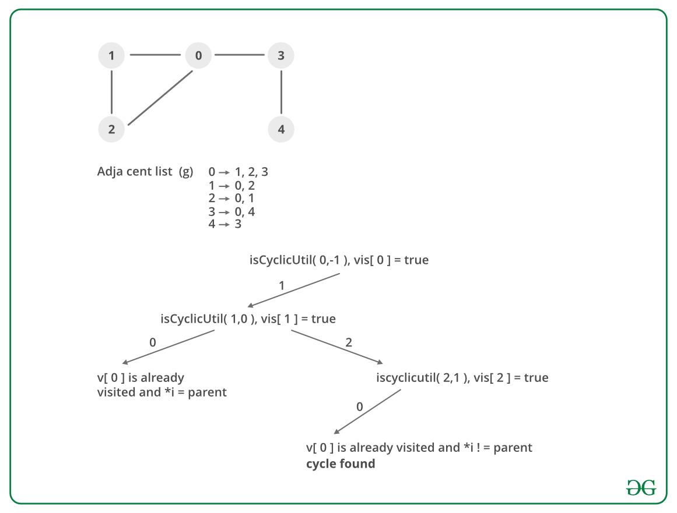
All about Complexities
Time Complexity :- O(v+e)
Space Complexity :- O(v)

Slide 17
Suggesting Common Movies and Actors/ Actresses
Strategy : Find all paths from the source vertex to the destination vertex
Source and Destination vertices are the favorite actors entered by the user
Finding all paths will give us access to the common movies and actors between them
More movies can be recommended
Similar actors can also be recommended

Slide 18
Underlying Algorithm
Algorithm follows Breadth-First Search approach (BFS)
We create a queue of paths and print these paths one by one.
Start with source vertex and add all connected vertices to a queue
For every path ‘p’ in the queue:
If last node of p is destination vertex:
Print the Path from source to p
Else
For all vertices connected to last node of p
Create new paths and add to the queue

Slide 19
Analysis
If there are V vertices between the source and destination node, there will be at most V paths inserted in the queue
For every connected vertex, we have at most V connected vertices
Hence, overall we are doing V queue operations and for every queue deletion we can insert V more paths
Overall Time Complexity : O(V^{V}) - Exponential
We can have at most V paths in the queue.
In every path we can have at most V nodes
Space Complexity : O(V^{V})

Slide 20
Thank You!

